Slide 1
Payroll Interface Training
Conference ID: 3 357 828 830
US & Any Country - Toll Call: +1-615-882-6682
US & Canada - Toll-free: +1-844-882-6682
Other local & International Numbers https://dialin.deloitte.com/
Host: Dan Fieldhouse - dfieldhouse@deloitte.com
1
Notes:
Third-Party Payroll Connectors allow you to manage payroll-related Human Resources data and send it to a third-party payroll provider. Worker synchronization, data changes, and worker events relevant to the payment process are configured so that appropriate next steps can be taken in the payroll system.
The advantage of these connectors is the relative ease-of-use and full set of integration features that require no custom code (though the interface is extensible if needed). With change detection built-in, the connector is configured by simply selecting which data and events are required by the accepting payroll system. The interface is pre-tested and supported by Workday, which means less development and testing for your implementation, reduced maintenance costs and risks to the project.

Slide 2
Cloud Connect for Third-Party Payroll Training
Agenda
Day 1 Overview Payroll Interface Setup Payroll Interface Example
Day 2 Staffing Events & Change Detection Functional Changes & PI
Day 3 Payroll Effective Change Interface (PECI) Functional Changes & PECI
Day 4 / Day 5 (if needed) Comparing PI to PECI Transformation & Delivery Wrap Up
Notes:
Course Overview

Slide 3
Change Detection

Slide 4
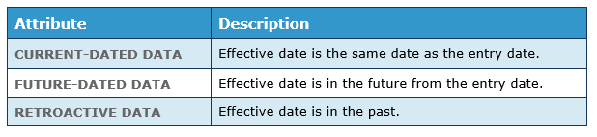
Dated Data and Comparison Dates
DATED DATA
All data entered in Workday are dated, both the date of entry and the date the change becomes effective. For each event, the entry date of that event is stored in the background while the effective date is required and stored along with the event. The effective date can be Current, Future-Dated, or Retroactive.
LAST SUCCESSFUL RUN AND PAY PERIOD DATES
Change detection compares data entry date/times and effective dates against three dates:
Last successful run date (LSRD)
Pay period start date
Pay period end date
Notes:
updated

Slide 5
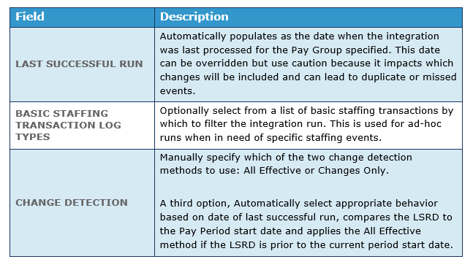
Change Detection Launch Parameters
Notes:
updated

Slide 6
Activity #1 – Setup PI for a Change File
Activity #2 – Run the PI with Change Detection

Slide 7
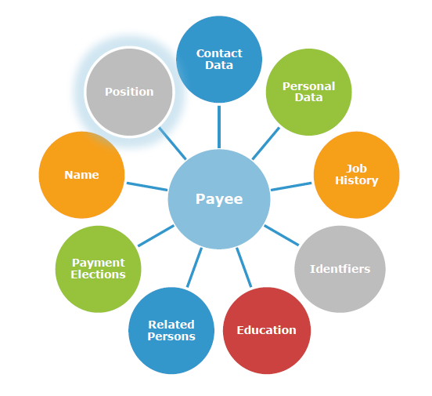
Employee / Payee Object Review
Understanding how data relates to the employee object model will help you plan and configure your integration. In this next section, we will see how Integration Attributes, Services, Field Attributes, Maps, and the XML output are organized around this object model.
Notes:
updated

Slide 8
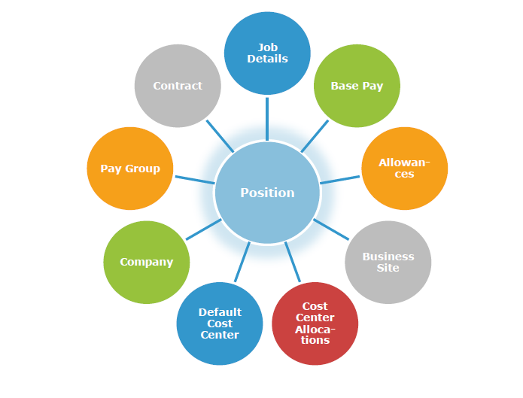
Employee / Payee Object Review
Understanding how data relates to the employee object model will help you plan and configure your integration. In this next section, we will see how Integration Attributes, Services, Field Attributes, Maps, and the XML output are organized around this object model.
Notes:
updated

Slide 9
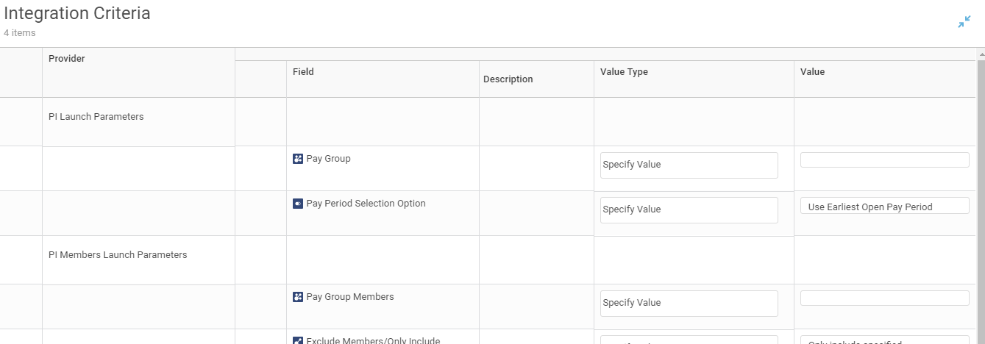
Workday Payroll Change Detection Methods
The Workday Payroll Interface will use one of the following two change detection methods when running in production:
All Changes Effective in Pay Period
All Changes Entered
Since Last Successful Run
Typically used for the first integration of the pay period
Includes changes effective in pay period
Excludes future-dated transactions in future pay periods
Used for incremental integration runs
Includes changes entered after last successful run date
Notes:
updated

Slide 10
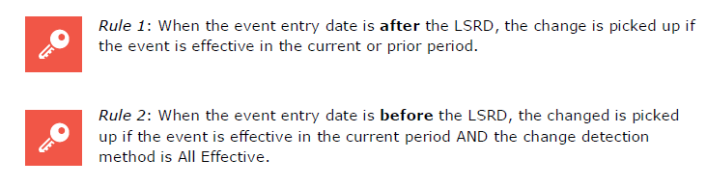
Change Detection Rules
Notes:
updated

Slide 11
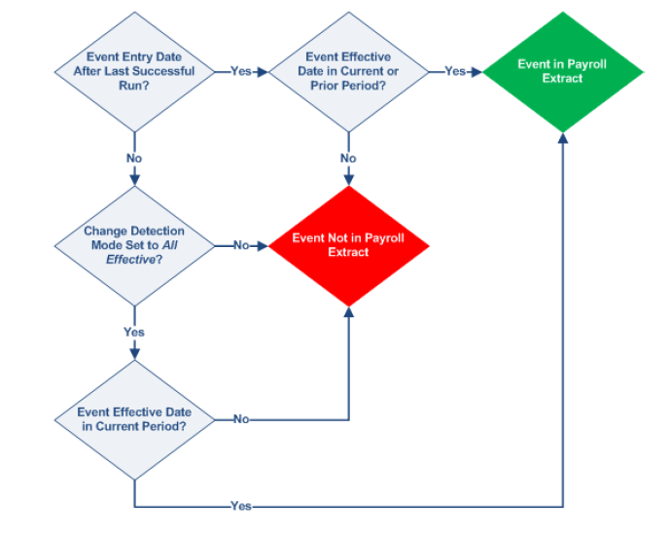

Slide 12
Primary vs. Non-Primary Payroll Integrations
Workday Payroll Interface allows the configuration of primary and non-primary payroll integrations :
Use when scheduling payroll interface runs
Performs change detection automatically
All effective for pay periods not yet started
Changes since last successful run for periods in progress
Launch parameters include pay group and pay period
Automatically updates last successful run date and period status
Not Yet Started -> In Progress
Pay period must be manually set to Complete
Primary Integration
Use for unscheduled runs
Does not update pay group or pay period status
Launch parameters include pay group, pay period, members, last successful run date, and change detection method
Change detection behavior defined in launch parameters
Non-Primary Integration
Notes:
updated

Slide 13
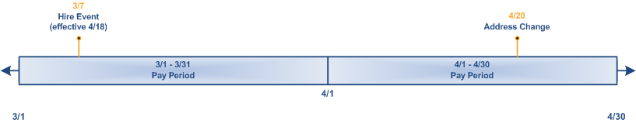
Understanding Data Change Inclusion
Payroll Integration Date | Default Change Detection Method | Changes Included in Payroll Extract
3/15 (first run) | All changes effective in the pay period | None. The hire event was entered after the last successful run, but is not effective in the current pay period.
3/31 (incremental run) | Only changes entered since last successful run | None. No events were entered after the last successful run.
4/15 (first run) | All changes effective in the pay period | Hire event. Although this event was entered before the last successful run, it is effective in the current pay period.
4/30 (incremental run) | Only changes entered since last successful run | Address change. This event was entered after the last successful run and is effective in the current pay period.

Slide 14
Activity #3 - #6 – Output Changes

Slide 15
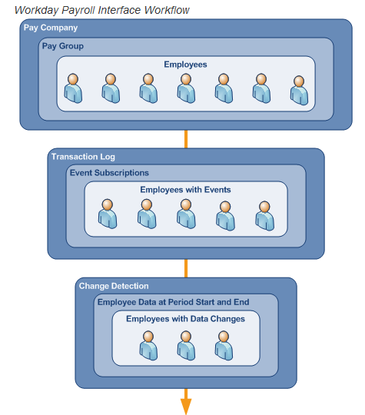
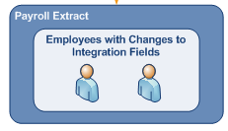
Payroll Integration Workflow
Select
Select workers for a specific pay group and pay period
Filter
Filter the workers based on the transaction log (if
configured)
Compare
Compare included data values from period start and period end
Exclude
Exclude workers without changes
Determine
Determine worker staffing details
Extract
Extract relevant employee data
Notes:
updated

Slide 16
Staffing Events Overview
The following employee staffing events are captured by the payroll interface and will result in data records being included:
In case of multiple staffing events, a top of stack rule applies which selects the most recently changed event in an order of precedence.
Staffing Event | Code | Description | Data Included
New Hire | HIR | Indicates first time employee is added to a pay group | All sections for employee
Termination | TRM | Included in the pay period that the employee is terminated | Status section plus any other data changes
Leave of Absence | LOA | Included with beginning of leave of absence | Status section plus any other data changes
Return from Leave | RFL | Included when leave of absence ends | Status section plus any other data changes
Transfer | PCI | Inbound transfer from payroll company | All sections for employee
Transfer | PCO | Outbound transfer from payroll company | All sections for employee in effect as of the day before the status event date.
Transfer | PGI | Inbound transfer from pay group (same payroll company) | All sections for employee
Transfer | PGO | Outbound transfer from pay group (same payroll company) | Status section only
Data Changes |  | Changes to data in the sections configured in the integration | Sections that contain changed data
Notes:
updated

Slide 17
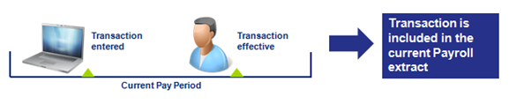
Transactions in the Current Period
Examples:
Regular Payroll Runs
One Time Payments
Notes:
updated

Slide 18
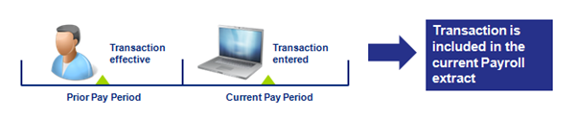
Transactions from a Prior Period
Example:
Retro Transactions from a Prior Period
A salary change was made to the worker’s compensation record to make his/her annual salary increase by $5,000. The transaction’s effective date is in a prior period, and the transaction was entered in the current pay period.
Notes:
updated

Slide 19
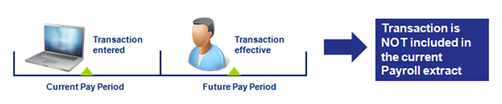
Transactions Effective in a Future Period
Example:
Future Dated Hire
A hire was entered into the system in the current pay period, but his/her effective date is in a future pay period.
Notes:
updated

Slide 20
Sample PICOF Output

Slide 21
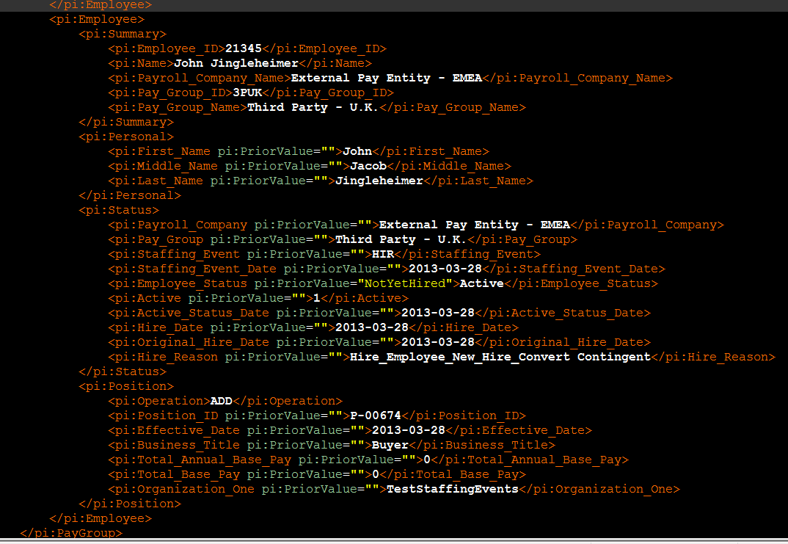
Employee Hired and Assigned a Pay Group

Slide 22
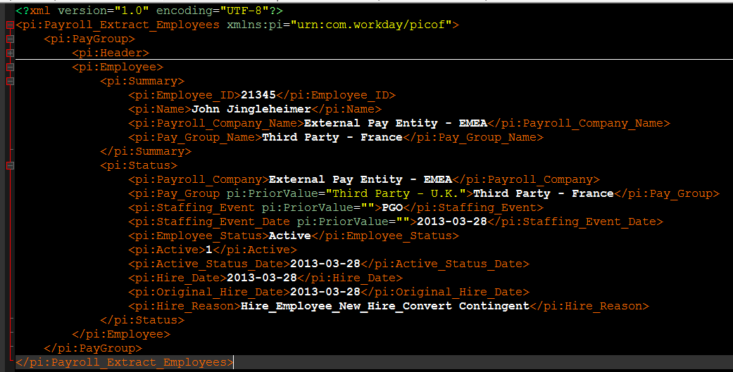
Employee Transferred To Another Pay Group 1

Slide 23
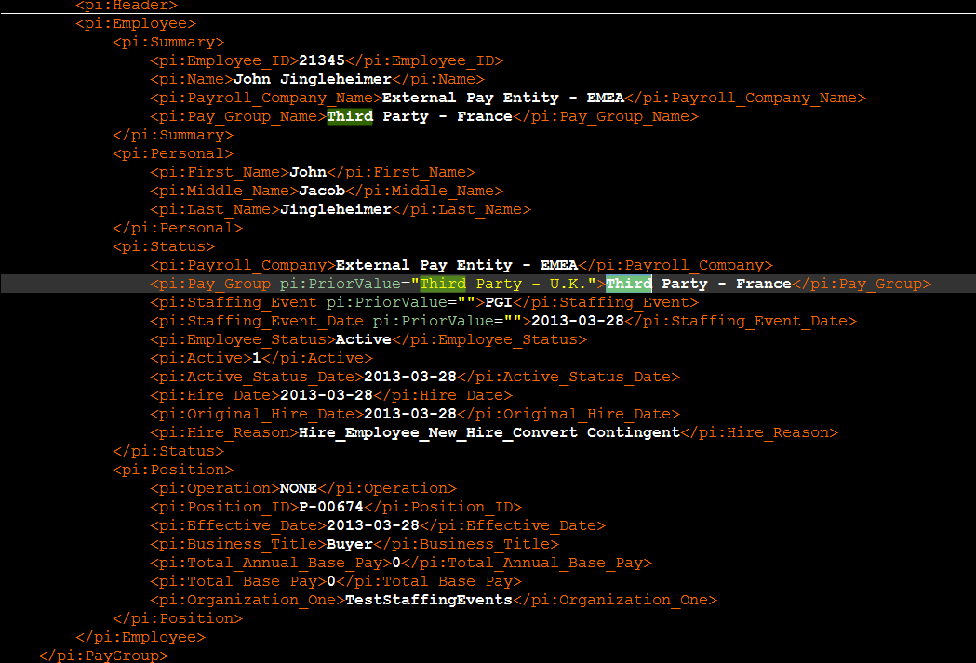
Employee Transferred To Another Pay Group 2

Slide 24
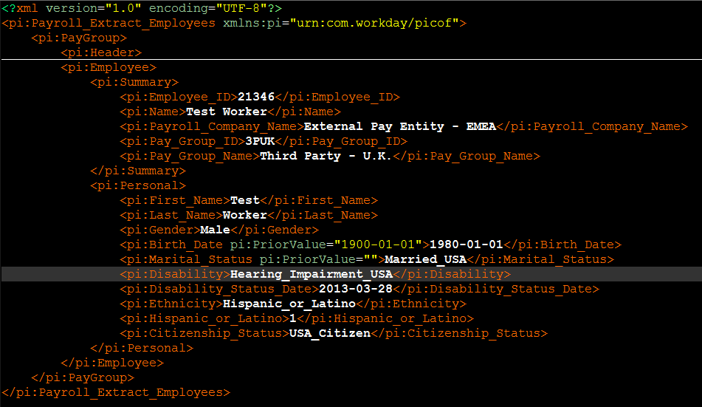
Employee Data Change

Slide 25
Day 2 Activities #7 - #10 & Questions

Slide 26

About Deloitte Deloitte refers to one or more of Deloitte Touche Tohmatsu Limited, a UK private company limited by guarantee (“DTTL”), its network of member firms, and their related entities. DTTL and each of its member firms are legally separate and independent entities. DTTL (also referred to as “Deloitte Global”) does not provide services to clients. Please see www.deloitte.com/about for a detailed description of DTTL and its member firms. Please see www.deloitte.com/us/about for a detailed description of the legal structure of Deloitte LLP and its subsidiaries. Certain services may not be available to attest clients under the rules and regulations of public accounting. Copyright © 2016 Deloitte Development LLC. All rights reserved. 36 USC 220506 Member of Deloitte Touche Tohmatsu Limited

